Slide 1
A Short ECHO Manual for Rectangular Structures
Igor Zagorodnov
1 April 2016

Slide 2
Contents
Create geometry file.
Check and correct geometry with Windows GUI version (if possible).
Prepare files for console version.
Calculate symmetric modes.
Post-processing for longitudinal and quadrupole wakes on axis.
Calculate antisymmetric modes.
Post-processing for dipole wake on axis.
Post-processing for longitudinal and transverse wakes for arbitrary offsets.
Accuracy check.

Slide 3
1. Create geometry file.
Format
n
t1 t2 t3 t4 t5 t6 t7 t8 t9 t10
…
n -number of elements;
t1 t2 – StartPoint (z,r);
t3 t4 –EndPoint (z,r);
t5 t6 t7 t8 - coordinates of square in which the ellipse is inscribed (for lines these parameters should be zeros) ;
t9 - orientation (clock/anticlock);
t10- conductivity in S/m
Geometry dimensions could be in mm/cm/m for console version. It would be better to use cm for compatibility with GUI version.

Slide 4
Example. File „Windows_GUI\photon_absorber_cm.txt “
5
0 6 1 6 0 0 0 0 1 0
1 6 1.01 3.2 0 0 0 0 1 0
1.01 3.2 1.91 3.2 0 0 0 0 1 0
1.91 3.2 2.82 6 0 0 0 0 1 0
2.82 6 2.92 6 0 0 0 0 1 0

Slide 5
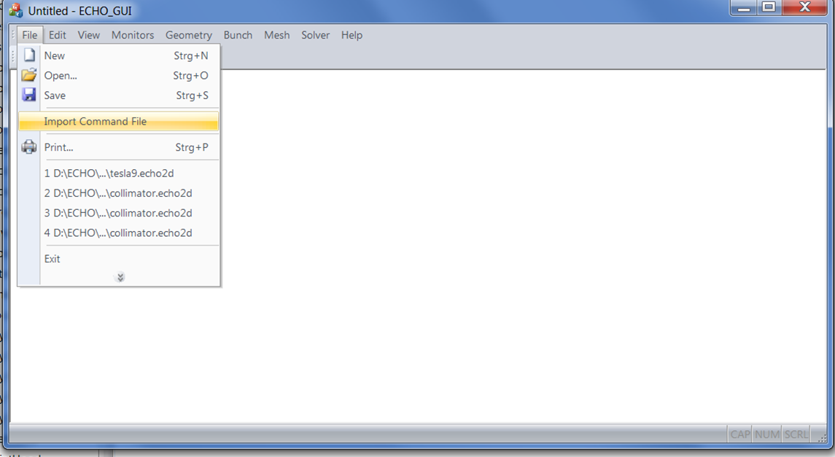
2. Check and correct Geometry with Windows GUI version (if possible)
Start “ECHO2D_GUI.exe”
Go to “File\Import Command File” and choose file “input_in.txt„ with coarse mesh parameters and a long bunch.

Slide 6
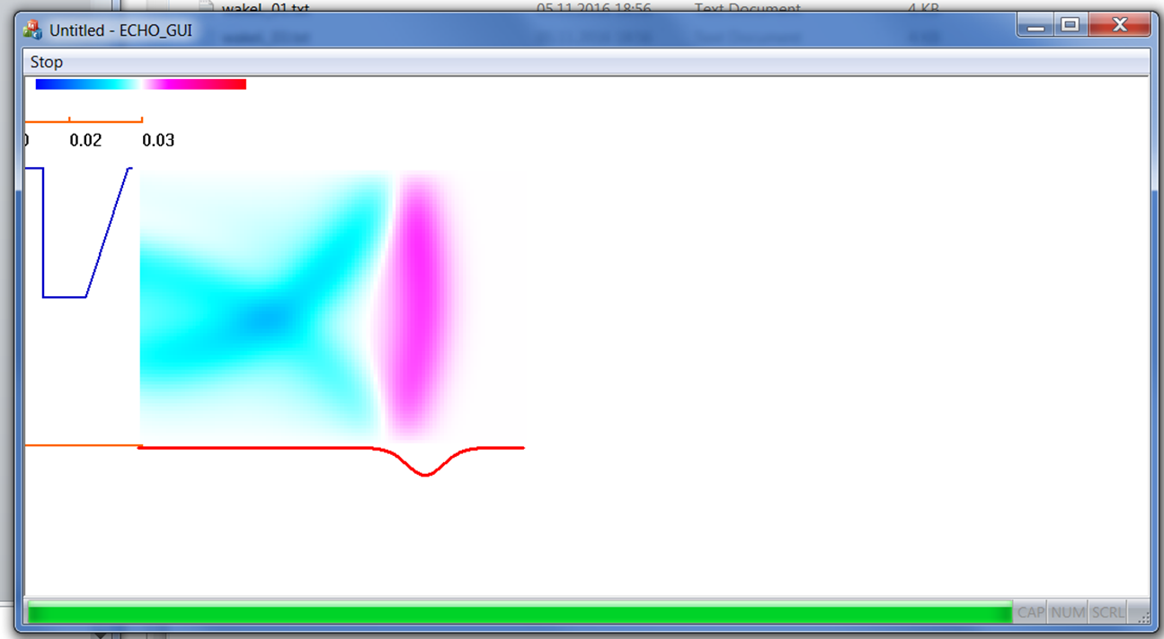
Go to „Solver\Start“ to run the calculation.

Slide 7
3. Prepare files for console version.
Directory “Windows_Console” or “MACOSX_Console” should have 3 files.
1. Executable „echo2D_THREADS.exe “.
2. Geometry file „photon_absorber_cm.txt “.
3. Command file „input_in.txt“.
In the command file all dimensions in meters. „Units“ are used only for „GeometryFile“ (cm in this example).
In all calculation it is recommended to use „Offset=-1“. It places the beam as close to the boundary as possible to increase an accuracy of higher order modes.

Slide 8
%%%%%%%%%%%%%% geometry %%%%%%%%%%%%%%%%%%%%
GeometryFile= photon_absorber_cm.txt % geometry in "Units"
Units= cm % m/cm/mm - only for GeometryFile!!!
GeometryType= recta % recta/round
Width= 0.07 % in m
SymmetryCondition= magn % magn/elec - boundary condition on axis
Convex=1; % 1(convex)/0(no)
%%%%%%%%%%%%%%% input beam and field %%%%%%%%%%%%%%%%%%
InPartFile= - % -(Gaussian pencil beam)
BunchSigma= 0.004 % in m
Offset= -1 % in mesh steps/-1(default, near wall)
InFieldFile= - % -(no output)
%%%%%%%%%%% model %%%%%%%%%%%%%%%%%%%%%%%%%
WakeIntMethod= ind % ind/dir/-
Modes=1 3 5 7 9 11 13 15
ParticleMotion= - % 1d/2d/3d/-
%%%%%%%% mesh %%%%%%%%%%%%%%%%
MeshLength=104 % in mesh steps
StepY=0.0008 %
StepZ=0.0008 %
NStepsInConductive=0 % 0(default)
TimeSteps=0 % 0(default)
%%%%%%%%%%% monitors %%%%%%%%%%%%%%%%
OutPartFile= - % -(no output)
OutFieldFile= - % -(no output)

Slide 9
4. Calculate symmetric modes.
For calculation of symmetric modes in command file the axis boundary condition has to be magnetic.
SymmetryCondition= magn % magn/elec - boundary condition on axis
Start „ echo2D_THREADS.exe“. A directory „magn“ will be created with modal wakes files in text format. The format can be found in file itself, see ,f.e., „magn\wakeL_01.txt“

Slide 10
5. Post-processing for longitudinal and quadrupole wakes on axis.
Start Matlab and open „\PostProcessor\Flat\PP_Wcc.m “.
Adjust „Nm“, „dir_in“ and „dir_out“.
Run this matlab file to create file „Wcc_odd.txt“ with modal wakes.
Matlab script „PP_Wcc.m“ creates two plots shown in the next slide.
The upper plot shows the modal wakes as they are calculated near to the boundary. The bottom plot shows the modal fictions Wcc as defined in the paper and which will be used to calculate wake for arbitrary offsets. The data from bottom plot are saved in file „Wcc_odd.txt“ .

Slide 12
With functions from „Wcc_odd.txt“ we can calculate longitudinal and quadrupole wakes on axis only .
Start Matlab and open „\PostProcessor\Flat\PP_WakeLQ.m “.
Adjust „Ncc“, „dir_in“ and „dir_out“.
Run this matlab file to create file „WakeLQ.txt“ with longitudinal and quadrupole wakes on axis. The format can be found in file „WakeLQ.txt“ itself.
Matlab script „PP_WakeLQ.m “ creates 4 plots shown in the next slide.
The longitudinal and quadropole wakes are on the right side. 3D plot at the left side are for estimation of the number of modes. It can be seen that we need on axis only a couple of modes in this example.

Slide 14
6. Calculate antisymmetric modes.
For calculation of antisymmetric modes in command file the axis boundary condition has to be electric.
SymmetryCondition= elec % magn/elec - boundary condition on axis
Start „ echo2D_THREADS.exe“. A directory „elec“ will be created with modal wakes files in text format. The format can be found in file itself, see ,f.e., „elec\wakeL_01.txt“

Slide 15
7. Post-processing for dipole wake on axis.
Start Matlab and open „\PostProcessor\Flat\PP_Wss.m “.
Adjust „Nm“, „dir_in“ and „dir_out“.
Run this matlab file to create a file „Wss_odd.txt“ with modal wakes.
Matlab script „PP_Wss.m“ creates two plots shown in the next slide.
Upper plot shows modal wakes as they are calculated near boundary. The bottom plot is modal fictions Wss as defined in the paper and which will be used to calculate wake for arbitrary offsets. The data from bottom plot are saved in file „Wss_odd.txt“ .

Slide 17
With functions from „Wcc_odd.txt“ and „Wss_odd.txt“ we can calculate longitudinal, dipole and quadrupole wakes on axis .
Start Matlab and open „\PostProcessor\Flat\PP_WakeLQD.m “.
Adjust „Ncc“, „dir_in“ and „dir_out“.
Run this matlab file to create file „WakeLQD.txt“ with longitudinal, dipole and quadrupole wakes on axis. The format can be found in file „WakeLQD.txt“ itself.
Matlab script „PP_WakeLQD.m “ creates 6 plots shown in the next slide.
The longitudinal, quadropole and dipole wakes are on the right side. 3D plot at the left side are for estimation of the number of modes. It can be seen that we need only a couple of modes in this example (on axis!).

Slide 19
8. Post-processing for longitudinal and lransverse wakes for arbitrary offsets.
With functions from „Wcc_odd.txt“ and „Wss_odd.txt“ we can calculate longitudinal and transverse (y-component) wakes for arbitrary offsets in y0,y .
Start Matlab and open „\PostProcessor\Flat\PP_WakeZY.m “.
Adjust “y”, “y0”, „Ncc“, „dir_in“ and „dir_out“.
Run this matlab file to create file „WakeZY.txt“ with longitudinal and transverse wake for the offsets y,y0. The format can be found in file „WakeZY.txt“ itself.
Matlab script „PP_WakeZY.m “ creates 4 plots shown in the next slide.
The longitudinal and transverse wakes are on the right side. 3D plot at the left side are for estimation of the number of modes. It can be seen that we need more than 8 modes in this example (near the boundary!).

Slide 21


8.Accuracy Check.
Double longitudinal mesh to check the accuracy (5/10 points on bunch sigma).
$W_{||}(s)$[V/pC]
$s$[mm]

